Slide 1



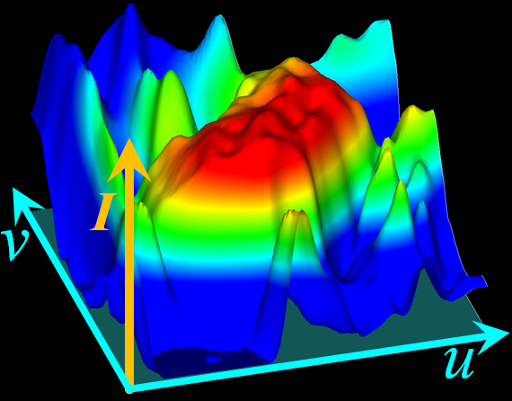
Bilateral Hermite Radial Basis Function for Contour-based Volume Segmentation
Takashi Ijiri¹, Shin Yoshizawa¹
Yu Sato², Masaaki Ito²,
Hideo Yokota¹
1. RIKEN
2. National Cancer Center
Notes:
We are going to present contour-based volume segmentation technique.

Slide 2
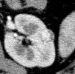
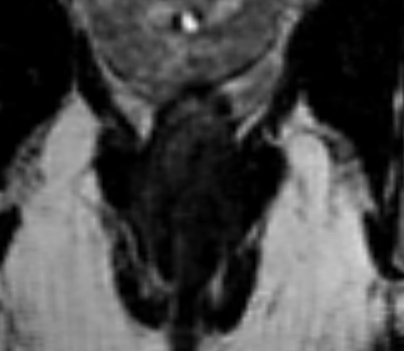
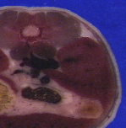
Introduction
Volume segmentation is fundamental
ｰ Extract information / Construct models
In bio-medical fields, it is necessary to segment ambiguous regions
User interaction is necessary to segment ambiguous regions
Only experts can recognize ambiguous regions
Tumor in CT
Muscle in MRI
Organs in ISM
Notes:
Introduction.
Volume segmentation is fundamental process to extract various information and to construct simulation models from volume images.
In bio-medical fields, it is often necessary to segment ambiguous regions, such as tumors in CT, muscles in MRI, or organs in color volumes.
Only experts can recognize these ambiguous regions.
Then user interaction is indispensable to segment these ambiguous regions

Slide 3
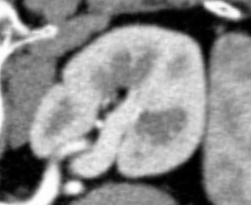
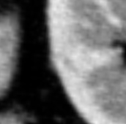
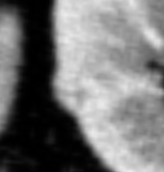
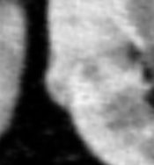
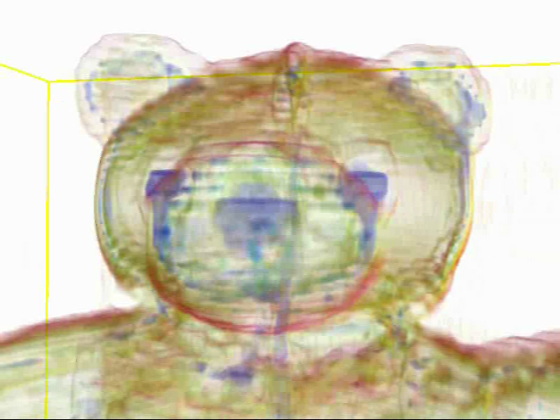
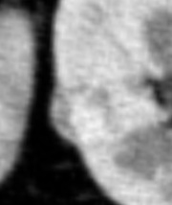
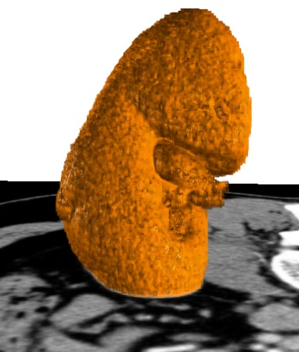
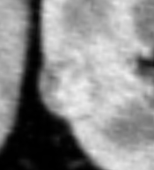
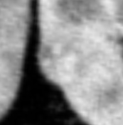
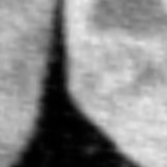
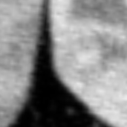
Interactive volume segmentation approaches
…
GraphCut, Region Growing, Active contours
Slice-by-slice
Contour-based
Seed-based
Time consume
☹
Moderate time
Easy & quick
Accurate
Accurate
☹
May cause error
Notes:
There are several interactive segmentation approaches.
The simplest way is full manual, slice-by-slice, segmentation.
With this approach, accurate segmentation is possible, but it is time consuming.
In contrast, some researchers presented seed-based segmentation, such as region growing or graph cut.
This method supports easy and quick segmentation;
however it may cause errors for ambiguous regions, because the seeds have rough inside/outside information.
We present a intermediate, contour-based segmentation. This is a CT volume of stuffed bear.
The user specifies several contours on the target region and the system computes boundary surface.
User interaction time is much smaller the slice-by-slice method.
Also, an accurate segmentation is possible because the user can specify contours directly on the ambiguous area.

Slide 4
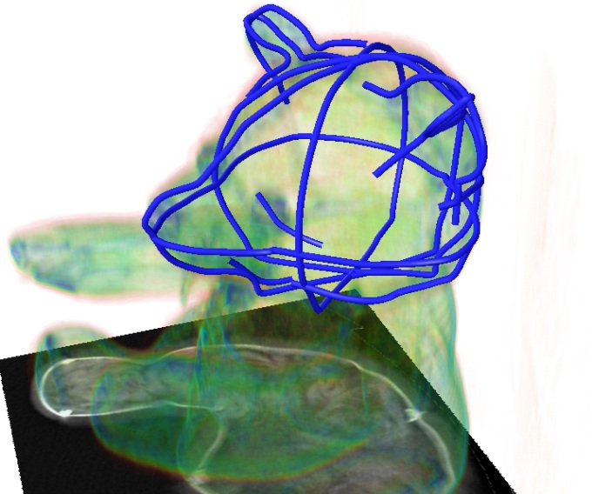
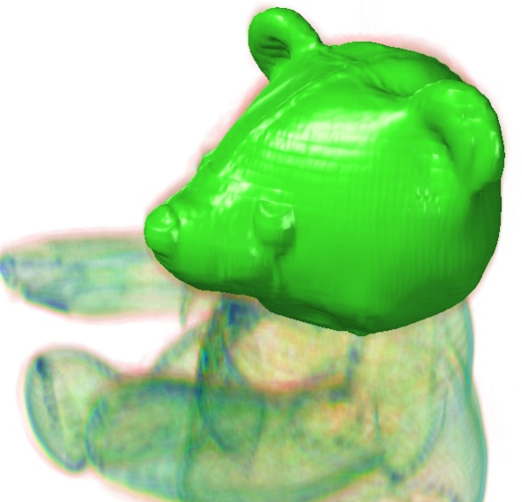
Our goal
Present a contour-based segmentation technique for ambiguous ROIs
Generate segmentation boundary that
-- pass through all contours
-- have smooth shape around blurred image area
-- fit to image edges around area with clear edges
Notes:
Our goal is to present a contour based segmentation technique for ambiguous regions.
When computing boundary surface from contour constraints, .
We would like to generate segmentation boundary that
- passes through all contours,
- has smooth shape around blurred image area,
and also
fits to image edges around image area with clear edges.

Slide 5
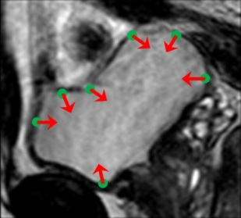

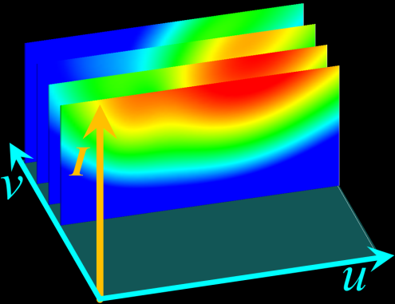
Our approach
・New technique based on implicit surface reconstruction
Input
[TO01; HKHP11]
Our technique
v
v
v
u
u
u
Constraints on 2D image
Scalar field on image
Scalar field on image manifold in
bilateral domain
・B-HRBF: New formulation to compute scalar field in bilateral domain
$f\left({\overline{p}}_{i}\right)=0$, $∇f\left({\overline{p}}_{i}\right)=normal$
$$f\left(\overline{x}\right)=\sum_{i}{\left(α_{i}φ(\overline{x}−{\overline{p}}_{i})−β_{i}∙∇φ(\overline{x}−{\overline{p}}_{i})\right)+a∙\overline{x}+b}$$
Notes:
To achieve this goal, we present a new segmentation technique based on implicit surface reconstruction.
When several constraints are specified on 2D image,
previous methods computes a signed scalar field on a image and extract its zero-level-set to obtain segmentation boundary.
With this method the boundary does not follow image edges.
Our key idea is to consider a bilateral domain.
We compute a signed scalar field in bilateral domain and resample its on image manifold surface.
With this extension, we obtain boundary that fits to image edges and have smooth shape around

Slide 6
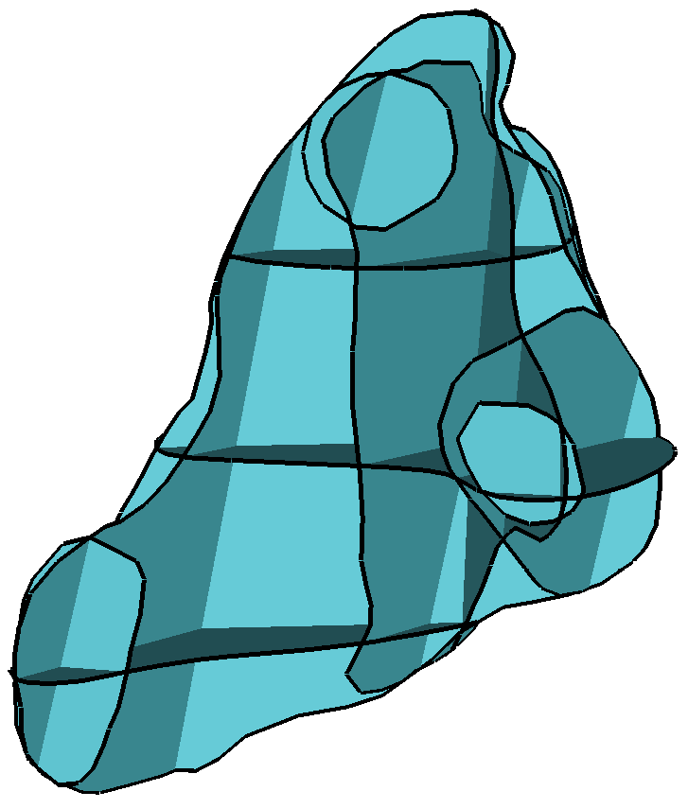
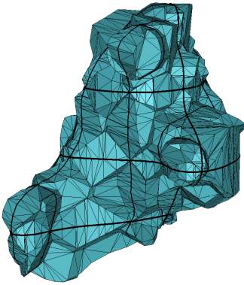
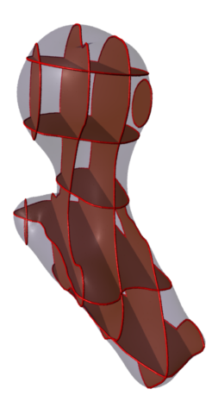
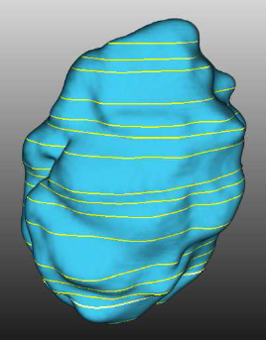
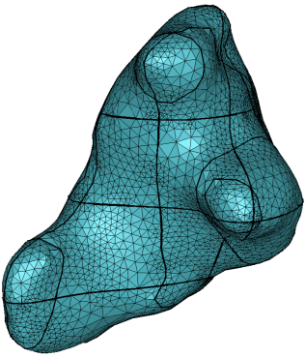
Previous contour-based technique
Contours
Initial surface
[Liu et al.
EG08]
[Turk et. al. SIGGRAPH 01]
[Heckel et. al.
VCBM 11]
Generalized Volonoi Diagram
Implicit surface
reconstruction
Our B-HRBF
Pass contours
✓
✓
✓
Smooth shape
✓
✓
✓
Fit image edge
☹
☹
✓
Notes:
We review previous contour-based segmentation techniques.
Liu et al applied generalized volonoi diagram.
They compute initial surface from contours by using generalized Volonoi diagram and then perform smoothing to obtain final boundary shape.
Some researchers applied implicit surface reconstruction technique.
They generate signed scalar field from contours and extract its zero-level-set as boundary.
These methods generates boundary surface that passes through all contours and has smooth shape.
However, it is difficult to fit the surface to image edges.
In contrast, our technique satisfy all requirements.

Slide 7
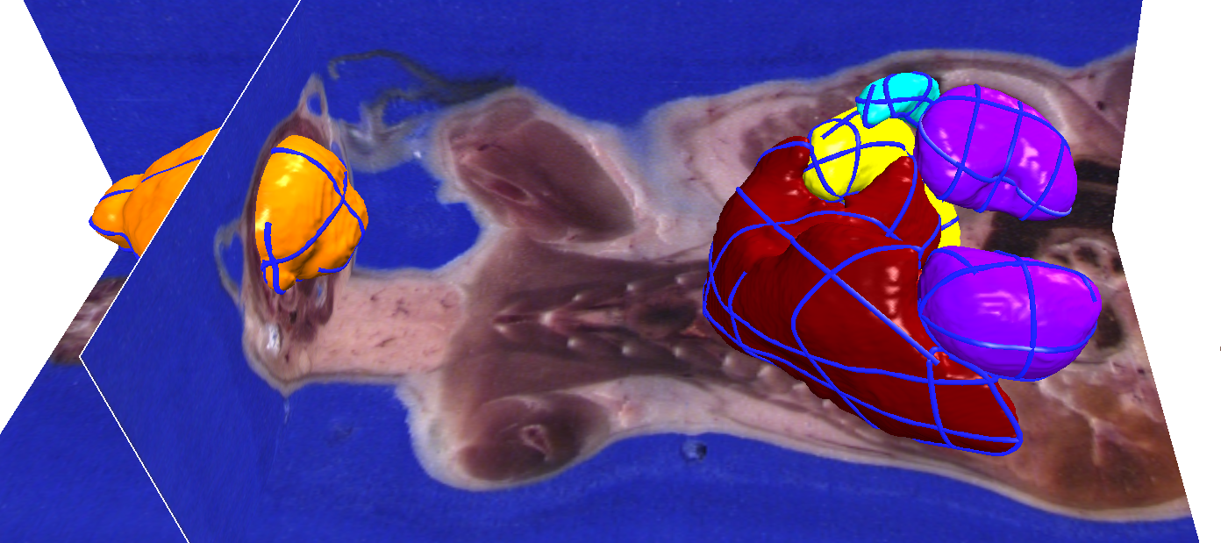
Demo
Video
(backup)
Notes:
Here we show a live demo of our method.
This is our prototype system. This is a color slice volume of a mouse.
The user first draws a cut stroke to place a cross section. Then the user next places a contour constraints like this.
After each operation, the system computes a segmentation boundary and returns feed backs.
As you can see, the boundary fits to image edges.
The user can flip the target side of the contour. The user can choose open or closed contour.
When finishing one contour, the user moves to the next contour.
If multiple contours are placed as this, the system generate a desired segmentation boundary.
As you can see, the boundary surface fits to image edges and have smooth shape around blurred image area.

Slide 8
B-HRBF segmentation
Overview
Gradient constraint
Contours → constraint points & normals
Notes:
We are going to show our method.

Slide 9
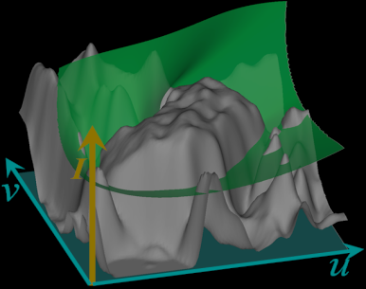
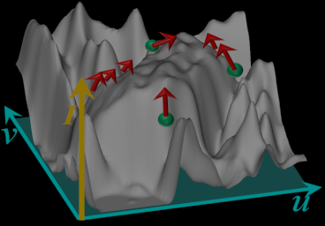
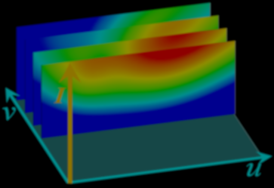
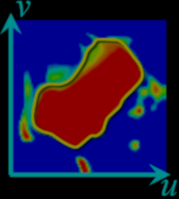
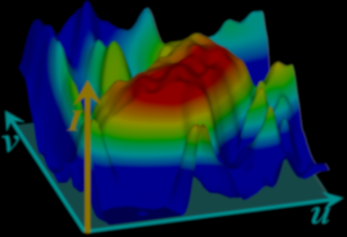
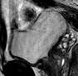
1. Image Manif
2. B-HRBF
3. Intersection
4. Zero-set on IM
2D gray scale image
Constraint
points p_{i}
normals n_{i}
of boundary surface
(curve in 2D)
Notes:
We use this 2D gray scale image, to explain our algorithm.
In this 2D case, the user specify multiple constraint “points and normals” of the desired segmentation boundary surface.

Slide 10

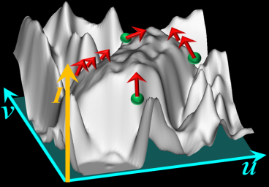

1. Image Manif.
2. B-HRBF
3. Intersection
4. Zero-set on IM
v
Bilateral domain (3D)
I
u
v
Range (value) domain (1D)
u
Spatial domain (2D)
Notes:
We consider an image manifold.
In the 2D image,
- all grid pixels are arranged in the uv “spatial domain”.
- each pixel has intensity value in “range domain”.
We joint the spatial domain and the range domain to obtain 3D bilateral domain.

Slide 11

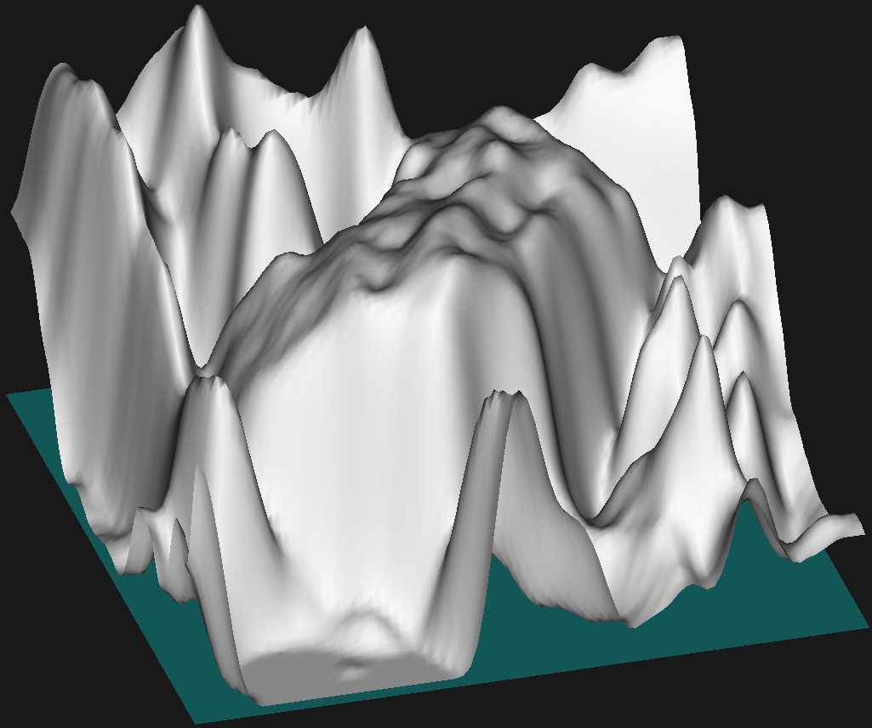

1. Image Manif.
2. B-HRBF
3. Intersection
4. Zero-set on IM
v
I(x)
I
u
v
x
u
$$r\left(x\right)=\left(\begin{matrix}x \\ w^{c}I(x)\end{matrix}\right)$$
Image Manifold
Notes:
We consider the image intensity I(x) at point x as height.
Then we obtain a height surface r(x). This surface is called as “image manifold”.
Image edge becomes steep slope in the image manifold.
There is a important parameter wc. wc scales the height of image manifold and then it controls the influence of image features.

Slide 12




1. Image Manif.
2. B-HRBF
3. Intersection
4. Zero-set on IM
v
I
u
v
Map constraint
u
points $p_{i}$ → ${\overline{p}}_{i}=r(p_{i})$
$J$ : Jacobian of r
normals $n_{i}$ → ${\overline{n}}_{i}=Jn_{i}/||Jn_{i}||$
Notes:
We map all these constraint points and normals in the spatial domain to the bilateral domain.
each point is mapped on the image manifold.
each normal is on the tangent plane of the image manifold.

Slide 13
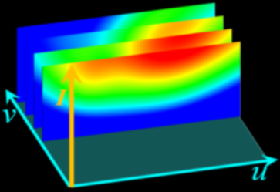
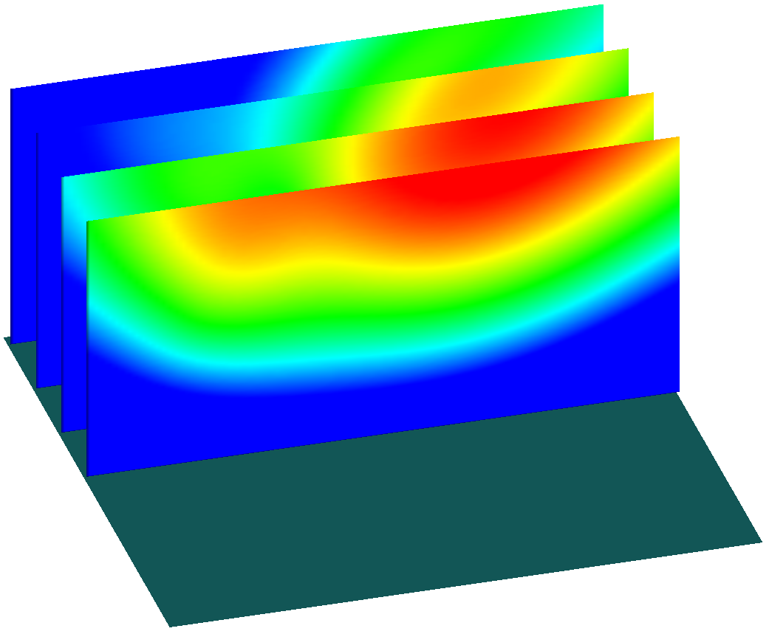
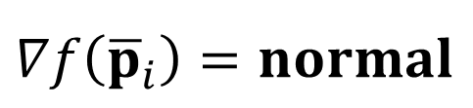
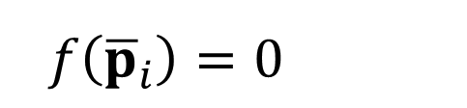

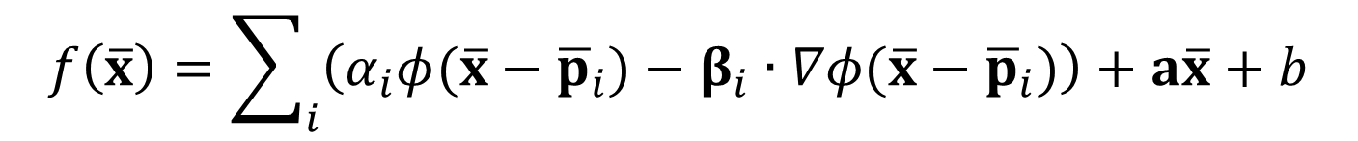
1. Image Manif
2. B-HRBF
3. Intersection
4. Zero-set on IM
v
I
u
v
Scalar field $f(\overline{x})$
$f\left({\overline{p}}_{i}\right)=0$
u
$$∇f\left({\overline{p}}_{i}\right)=normal$$
Bilateral-HRBF
$$f\left(\overline{x}\right)=\sum_{i}{\left(α_{i}φ(\overline{x}−{\overline{p}}_{i})−β_{i}∙∇φ(\overline{x}−{\overline{p}}_{i})\right)+a\overline{x}+b}$$
Notes:
Next, we compute a signed scalar field f(x) in the bilateral domain,
so that
it has zero value at all constraint points,
and
it’s gradient at each point is equal to the normal constraint
We adopt hermit radial basis function interpolation to obtain smooth scalar field.
We call this scalar field in the bilateral domain as Bilateral Hermite radial basis function, B-HRBF

Slide 14
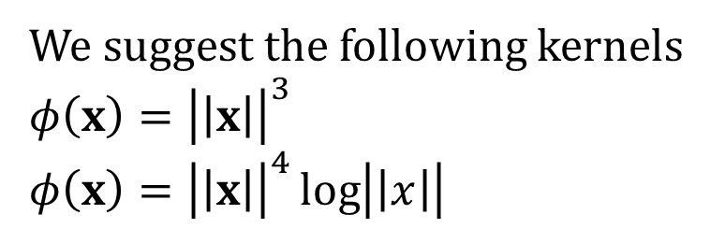
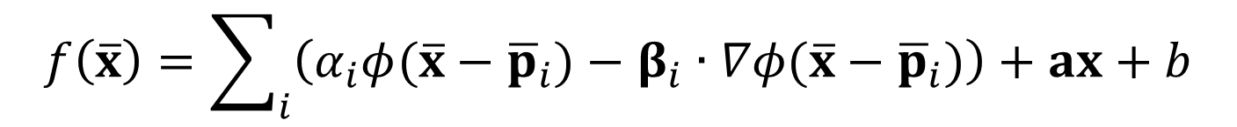
1. Image Manif
2. B-HRBF
3. Intersection
4. Zero-set on IM
v
We suggest the following kernels
$φ\left(x\right)={\left|\left|x\right|\right|}^{3}$
$φ\left(x\right)={\left|\left|x\right|\right|}^{4}\log\left|\left|x\right|\right|$
I
u
v
Scalar field $f(\overline{x})$
$f\left({\overline{p}}_{i}\right)=0$
u
$$∇f\left({\overline{p}}_{i}\right)=normal$$
Bilateral-HRBF
$$f\left(\overline{x}\right)=\sum_{i}{\left(α_{i}φ(\overline{x}−{\overline{p}}_{i})−β_{i}∙∇φ(\overline{x}−{\overline{p}}_{i})\right)+ax+b}$$
Notes:
Our experiments suggested these kernels.

Slide 15
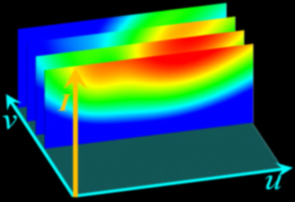
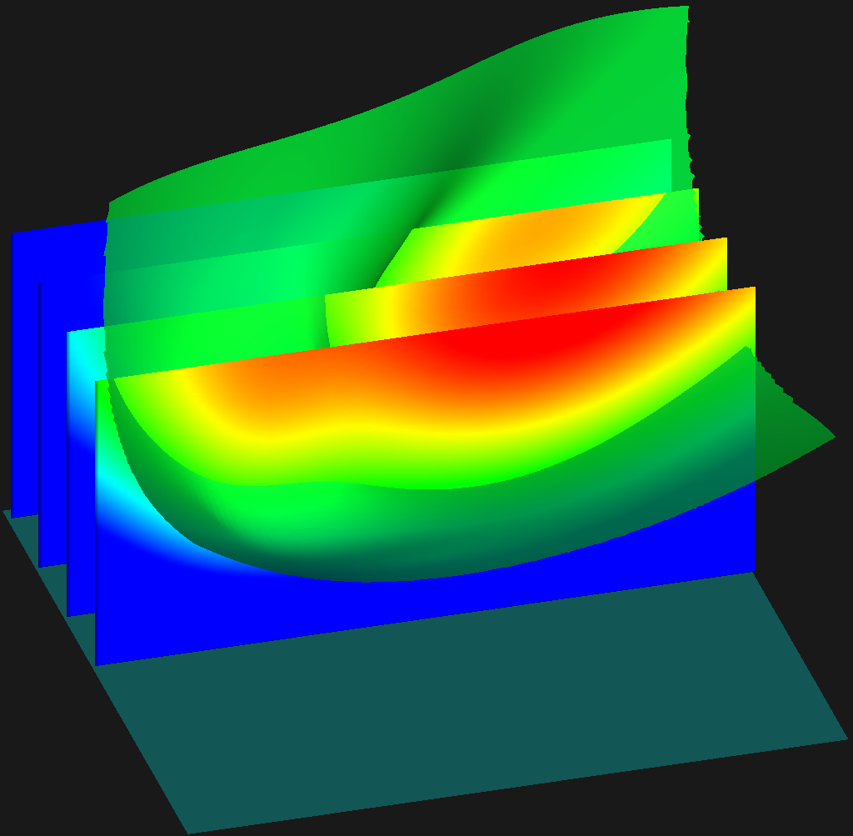


1. Image Manif.
2. B-HRBF
3. Intersection
4. Zero-set on IM
v
I
u
v
Zero-set of $f(\overline{x})$
u
$$\left\{\overline{x} \right| f\left(\overline{x}\right)=0\}$$
Notes:
We extract zero-level-set as B-HRBF

Slide 16
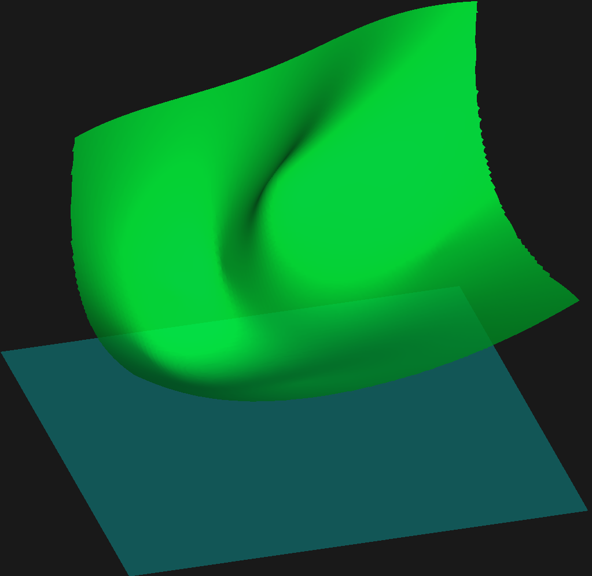
1. Image Manif
2. B-HRBF
3. Intersection
4. Zero-set on IM
v
I
u
v
Zero-set of $f(\overline{x})$
u
$$\left\{\overline{x} \right| f\left(\overline{x}\right)=0\}$$

Slide 17
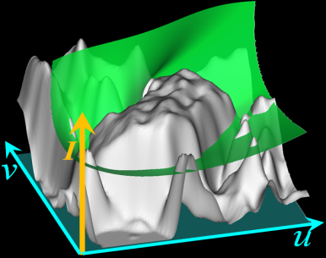
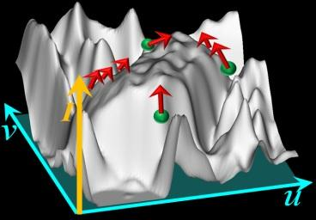
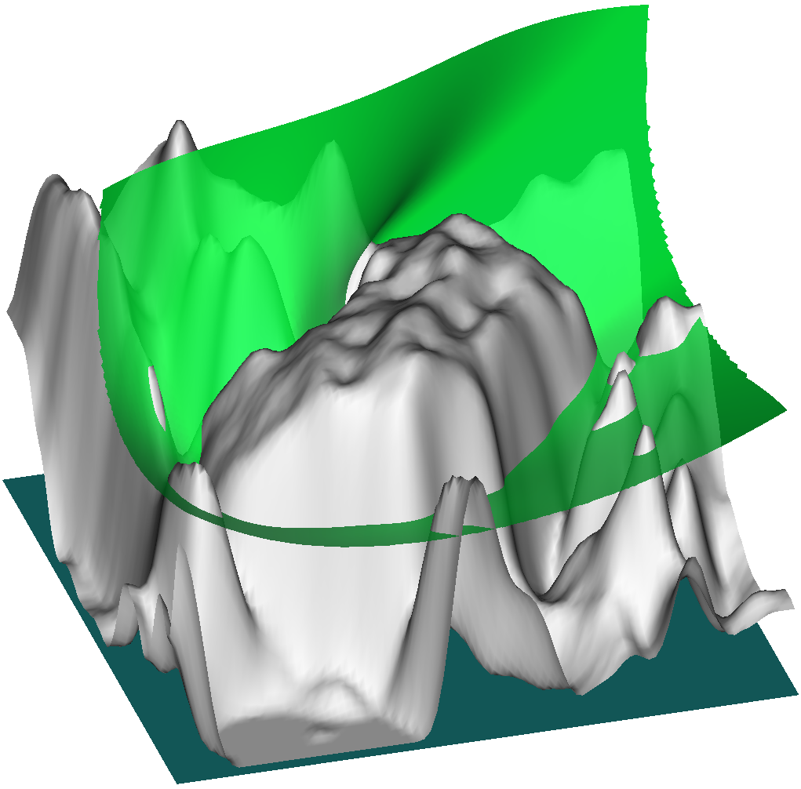

1. Image Manif
2. B-HRBF
3. Intersection
4. Zero-set on IM
v
I
u
v
Our new idea!!
u
Defined boundary as
intersection zero-set of $f(\overline{x})$& Image manifold
Notes:
Finally, we define the boundary surface as the intersection between the zero level set of the scalar field and image manifold.
This is a 2D visualization.
There are several unnecessary intersections highlighted with the red curves.
We ignore them in the computational process and obtain segmentation boundary.

Slide 18
1. Image Manif.
2. B-HRBF
3. Intersection
4. Zero-set on IM
v
I
u
v
u
Smoothing effect
Blurred image area forms flat shape in image manifold
The smoothness of zero-set of is dominant
Notes:
With this method, we obtain smoothing effect in blurred image area..
Blurred image area forms flat shape in image manifold.
In such region, the smooth ness of zero-set is dominant.
Then we obtain smooth boundary around blurred image area.

Slide 19
1. Image Manif.
2. B-HRBF
3. Intersection
4. Zero-set on IM
v
I
u
v
u
Edge fitting effect
Image edges form steep slopes in image manifold
Intersection of zero-set and image manifold often occur
Notes:
With this method, we obtain image fitting effect.
Image edge forms steep slopes of the image manifold.
In such region, the intersection between the zero-set and image manifold often occur.
As a result, boundary fits to image edges.

Slide 20
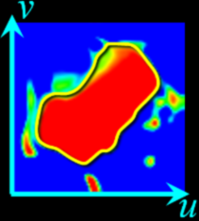
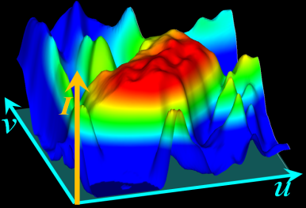
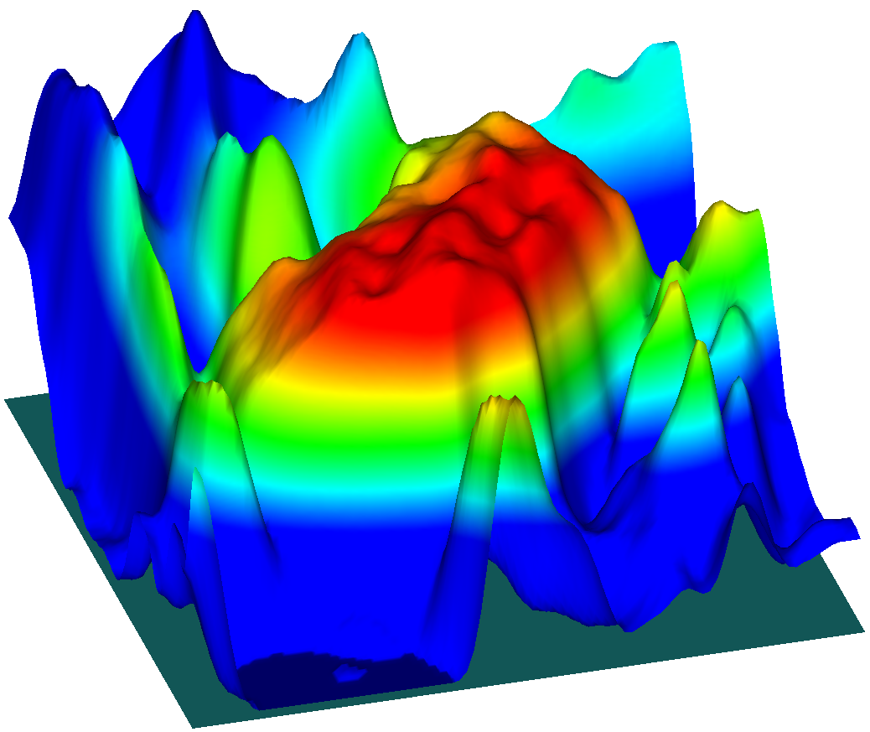
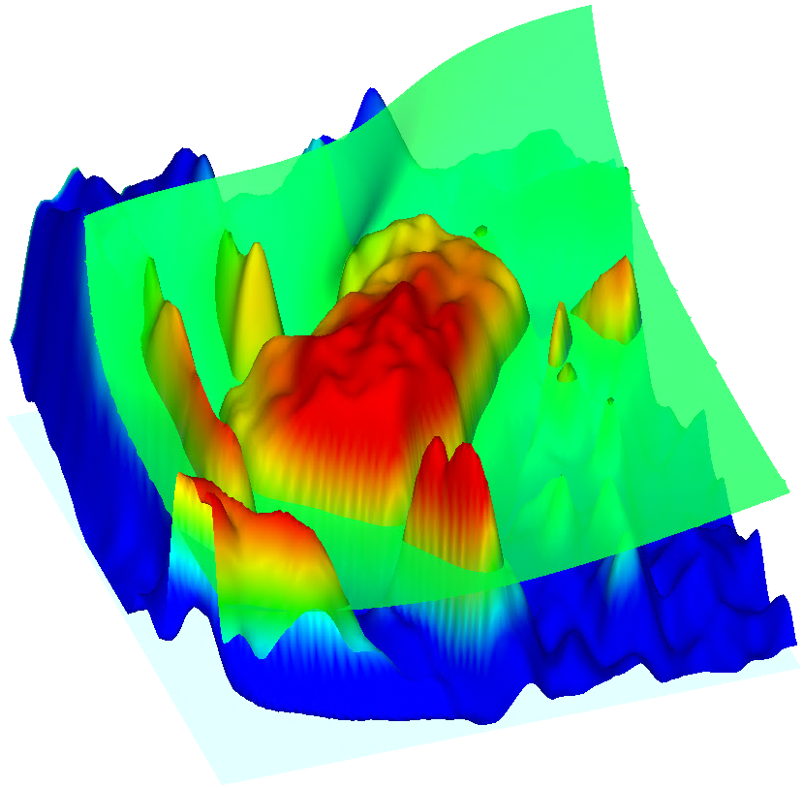


1. Image Manif
2. B-HRBF
3. Intersection
4. Zero-set on IM
v
I
I
u
v
v
+ Evaluate scalar field on
image manifold $f\left(r\left(x\right)\right)$
+ Extract zero set on image
manifold $\{x|f\left(r\left(x\right)\right)=0\}$
u
u
+ Apply surface tracking marching cubes [SFYC*96]
Notes:
To compute intersections of two surfaces is time consuming and is not necessary.
What we have to do is
to resample the scalar field on the image manifold.
Extract zero-level set of the scalar field on the image manifold.
This is a 2D visualization of the scalar field.
We extract zero level set of this 2D scalar field.
We apply surface tracking marching cubes method
to accelerate the computation and ignore unnecessary zero-set;

Slide 21





s-D r-ch Image
s-manifold in s+rD
2D
grayscale
2-manifold in (2+1)D
3D
grayscale
3-manifold in (3+1)D
3D
RGB
3-manifold in (3+3)D
Notes:
Our technique can be generalized s-dimensional r-channel images.
For 2D grayscale image, we consider 2-image-manifold in 3D bilateral domain.
For 3D grayscale volue, we simply consider 3-image-manifold in 4D bilateral domain
For 3D color volume , we consider 3-image-manifold in 6D bilateral domain
Please see the paper for the general definition.

Slide 22



B-HRBF segmentation
Overview
Gradient constraint
Contours → constraint points & normals
$f\left({\overline{p}}_{i}\right)=0$
B-HRBF
$$∇f\left({\overline{p}}_{i}\right)=normal$$
$$f\left(\overline{x}\right)=\sum_{i}{\left(α_{i}φ(\overline{x}−{\overline{p}}_{i})−β_{i}∙∇φ(\overline{x}−{\overline{p}}_{i})\right)+a\overline{x}+b}$$
Notes:
Next, we explain how to specify the gradient constraint of B-HRBF

Slide 23


$$∇f\left({\overline{p}}_{i}\right)=\frac{Jn_{i}}{||Jn_{i}||}$$
Normal is on tangent plane of image manifold
Zero-set becomes near orthogonal to steep slopes of image manifold
Intersection between zero-set and slopes of image manifold often occur
_{Zero-set}
I
→ Edge fitting effect
uv
Image manifold
Notes:
This is a 2D illustration of the bilateral domain.
This curve is the image manifold.
The use specify points and normals on the image.
As I mentioned, we map each points on the image manifold
We map each normal onto the tangent plane of the image manifold by using Jacobian J of image manifold.
If we use this normal for gradient constraint, the zero level set become near orthogonal to steep slopes of image manifold. This is a 3D visualization.
In this case, the intersection between zero-level-set and steep slopes often occur.
As a result, this normal constraint enhance edge fitting effect.
Sometimes the edge fitting effect is too strong to generate false positive region.

Slide 24



$$∇f\left({\overline{p}}_{i}\right)=\left(\begin{matrix}n_{i} \\ 0\end{matrix}\right)$$
Translate the spatial domain normal
Zero-set is near orthogonal to spatial domain
The shape of image manifold is unimportant
I
→ Smoothing effect
uv
Notes:
Next we consider this formulation.
We simply translate the spatial domain normals into bilateral domain.
With this gradient constraint, the zero-level-set become near orthogonal to spatial domain.
In this case, the shape of image manifold is not very important.
This formulation enhance the smoothing effect.
But, the smoothing effect is too strong, and the boundary dose not fit to image edges.

Slide 25



$$∇f\left({\overline{p}}_{i}\right)=α\frac{Jn_{i}}{||Jn_{i}||}+(1−α)\left(\begin{matrix}n_{i} \\ 0\end{matrix}\right)$$
I
Blend the two types of normals
→ Balance smoothing and edge fitting effects
uv
Notes:
So, we blend the two normals. This is our final formulation.
This is a segmentation result.
With this blended normal, we can balance smoothing and edge fitting effect and achieve desired segmentation boundary.

Slide 26


B-HRBF segmentation
Overview
Mapping normals
Contours → constraint points & normals
$$p_{i}, n_{i}$$
Notes:
We are going to show our method.

Slide 27








Contour → $p_{i}$ $n_{i}$
0. Cross section & contour
1. Resample with an interval - $p_{i}$
2. Compute base normal as -
${n_{i}}^{0}$ = $t_{i}×c_{i}/||t_{i}×c_{i}||$
c_{i}
[HKHP11]
t_{i}
p_{i}
p_{i}
$$n_{i}^{0}$$
$t_{i}:$ tangent of contour
$c_{i}:$ normal of cross section
Notes:
This is an artificial spherical volume.
0) The user place a cross section and contour on it.
1) We first resample the contour to obtain constraint points.
2) We next compute a base normal as the cross product of the tangent vector of the contour and the normal of the cross section.
we compute the base normal at all points.

Slide 28






Contour → $p_{i}$ $n_{i}$
0. Cross section & contour
1. Resample with an interval - $p_{i}$
2. Compute base normal as -
${n_{i}}^{0}$ = $t_{i}×c_{i}/||t_{i}×c_{i}||$
[HKHP11]
p_{i}
$$n_{i}^{0}$$
The base normal has problem
☹
Artifact
Contours are orthogonal / slanted to target region
Notes:
This base normal is always on the cross section and then it has problem.
When contours are orthogonally to the target region. It works well.
However,
the contours are slanted to the target region. It cause artifact.

Slide 29








Contour → $p_{i}$ $n_{i}$
0. Cross section & contour
1. Resample with an interval - $p_{i}$
2. Compute base normal as -
${n_{i}}^{0}$ = $t_{i}×c_{i}/||t_{i}×c_{i}||$
3. Modify ${n_{i}}^{0}$ → $n_{i}$ with heuristics
p_{i}
$$n_{i}^{0}$$
$$n_{i}^{}$$
- Use image gradient $∇I$
- Align base normal to $∇I$
- Use intersection of contours
- Desired normal is $t_{l}×t_{m}$
Notes:
Then, we modify the base normals.
We introduce two heuristic approaches approaches
The first approach uses image intensity gradient at each point.
We align the base normals into the gradient direction.
The second approach uses intersection information of specified contours.
At each intersection, a desired normal is obtained by cross product of tangent vectors of intersecting contours.
Please see the paper for detail.

Slide 30


Contour → $p_{i}$ $n_{i}$
0. Cross section & contour
1. Resample with an interval - $p_{i}$
2. Compute base normal as -
${n_{i}}^{0}$ = $t_{i}×c_{i}/||t_{i}×c_{i}||$
3. Modify ${n_{i}}^{0}$ → $n_{i}$ with heuristics
p_{i}
$$n_{i}^{}$$
Normal $n_{i}$avoid artifact
even with slanted contours
Notes:
With this modified normals, we obtain desired segmentation results even if the contours are slant to the target region.

Slide 31



Results
- We applied our technique to biomedical images
- Results were evaluated from experts
Notes:
Finally, we show several segmentation results.
We applied our segmentation technique to biomedical image
All segmentation results were evaluated from exports

Slide 32





Right thigh segmentation (CT)
Cross section
- 5 bones & 9 muscles
- Less than 30 min to segment each
Notes:
This is a thigh segmentation example.
We segment 5 bones and 9 muscles from CT volume.
It took less than 30 minutes to segment each region.
As in this cross section, contacting muscles have ambiguous boundary.
But our method allows the user to achieve accurate segmentation.

Slide 33








Comparison with previous seed-based methods
Ground truth
Graph cut
Region grow
Our B-HRBF
- Tried to obtain same segmentation with three methods
- ROI has clear boundary (top) : all methods worked well
- ROI has blurred boundary (bottom): seed based methods failed
Notes:
This slide show the comparison with previous seed-based methods.
We segmented muscle region from 2D CT image. These are the ground truth.
We tried to generate same segmentation boundary with three methods, such as graph cut region growing and our metho.
When the target region has clear boundary as in the top row, all methods work well.
But when the target region has blurred boundary as in the bottom row, fails to generate desired boundary.
Because the user specified seeds only have rough inside-outside informaton.

Slide 34





Comparison with previous contour-based method
Cross section
Cross section
[TO02; HKHP11]
Input contours
Our method
Previous method
Implicit-surface reconstruction
- Separated surfaces around shaft
Prev. method
- miss edges around joint
Notes:
This slide shows a comparison with previous contour-based method.
From these contours, we computed segmentation boundary with our method and previous method based on implicit surface reconstruction
The previous method results in separated surface in area where the contours are specified sparsely.
This is a cross section of the joint region.
Although previous method miss image edges since they do not consider image features, our method achieves to fit image edges.

Slide 35

Conclusion
New volume segmentation technique
Compute scalar field in bilateral domain with B-HRBF
Define boundary as Intersection of zero-set and image manifold
Acceleration scheme of B-HRBF (omitted)
An contour-based user interface for segmentation
I
v
u
Notes:
In conclusion, we present a new segmentation algorithm
that
compute scalar filed in the bilateral domain.
and
define the intersection between the zero-level-set of the field and image manifold as boundary.
We also present a new contour-based volume segmentation user interface.
We could not talk about this today, but, we also present several acceleration technique of the algorithm.

Slide 36



Thank you for your attentions
Notes:
33
目次 - 5
実質 – 6
22

Slide 37

Limitation & future work
To find good arrangement of contours is difficult for novices
→ To support to find nice contour
arrangement
Bad example
+ unnecessary contours exist
+ additional contours required
Contour-based user interface is only for 3D
→ User interface for higher dimensional volume
Notes:
One limitation is that it is difficult for novice users to find nice arrangement of contours.
In this example, some contours are unnecessarily.
In the future, we would like to provide a method to find better position of new contours.
Our segmentation algorithm is available for any dimensional image.
However our contour based UI is designed only for 3D volume and to provide UI for higher dimensional image is our future work.

Slide 39

Main bottleneck of algorithm
When computing BHRBF
$$f\left(\overline{x}\right)=\sum_{i}{\left(α_{i}φ(\overline{x}−{\overline{p}}_{i})−β_{i}∙∇φ(\overline{x}−{\overline{p}}_{i})\right)+a\overline{x}+b}$$
$$f\left({\overline{p}}_{i}\right)=0, ∇f\left({\overline{p}}_{i}\right)=normal$$
We have to solve dense and large linear system
A
x
b
U
x
b
=
=
L
We solve the linear system by LU-factorization based method ← this is the main bottleneck

Slide 40

Acceleration of LU factorization
stored contour (fixed)
Active contour (can be change)
User edits only one contour at a time
Matrix consists of 2 parts (correspond to active/stored contour)
Pre-compute LU factorization of stored contour part
Compute LU factorization only a part correspond to active contour
Correspond to stored contour
A
A
U
L
active contour

Slide 41

Acceleration of LU factorization
All contours are stored and we factorized HRBF matrix in LU form
A
=
L×U
The user may select a contour to activate (to re-edit)
HRBF matrix consists of two part
Correspond to activated contour / stored contour
We sweep a part correspond to active contour to right・bottom keeping a the LU form [Gondzio’s algorithm]
A
=
L
U
A’
=
×
L’
×
U’
Selected contour

